Slide 1
Lecture#7: Stack & Recursion (Chapter#8) Summer, 2025
Embedded Systems with ARM Cortex-M Microcontrollers in Assembly Language and C
CSE331: Microprocessor Interfacing and Embedded Systems
Credit: Dr. Mohammad A. Qayum

Slide 2
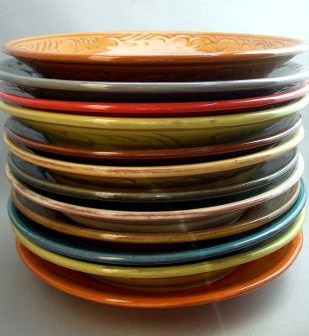
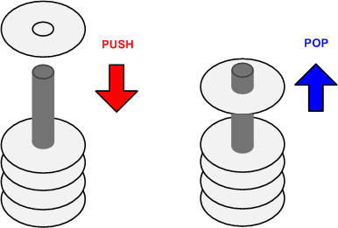
Stack
A Last-In-First-Out data structure
Only allow to access the most recently added item
Also called the top of the stack
Key operations:
push (add item to stack)
pop (remove top item from stack)

Slide 3
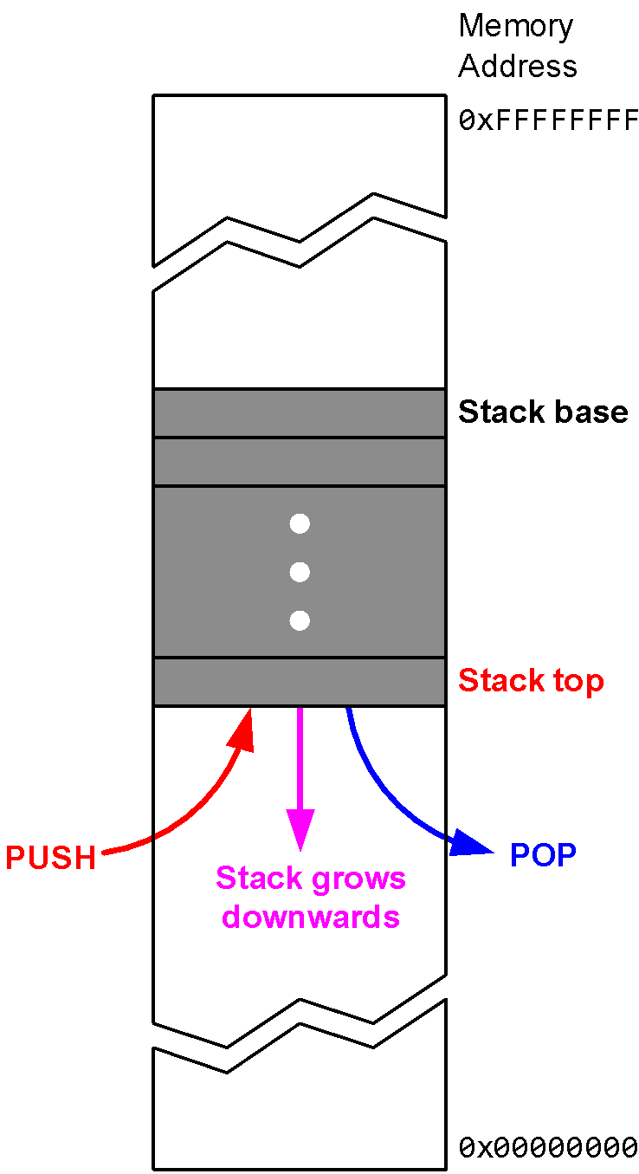
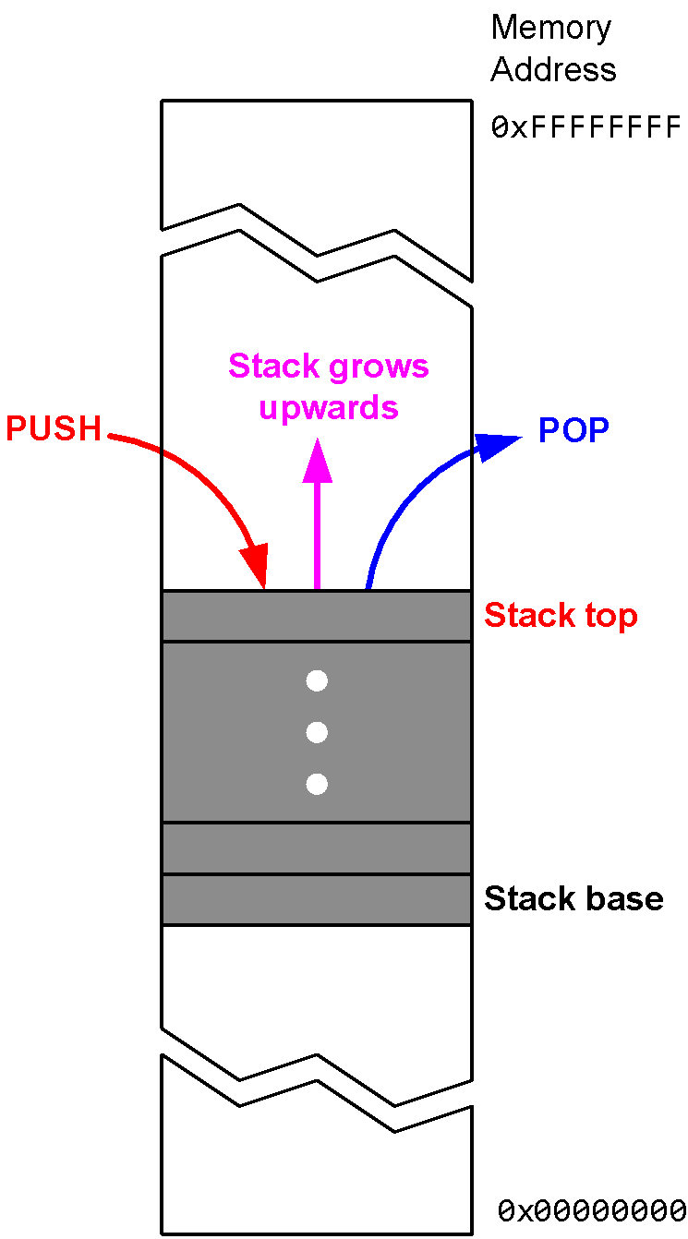
Stack Growth Convention: Ascending vs Descending
Descending stack: Stack grows towards low memory address
Ascending stack: Stack grows towards high memory address

Slide 4
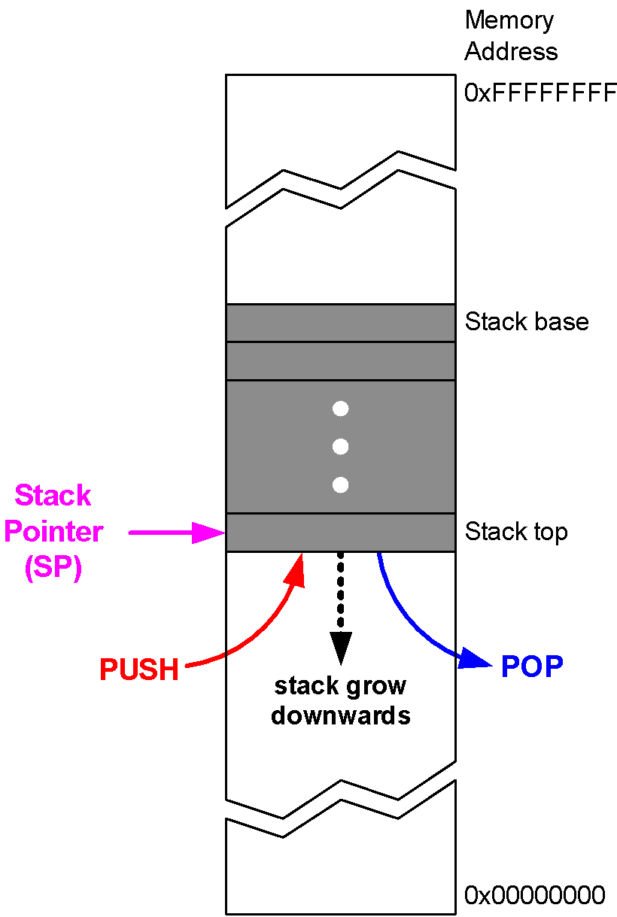
Cortex-M Stack
stack pointer (SP) = R13
Cortex-M uses full descending stack
stack pointer
decremented on PUSH
incremented on POP
SP starts at 0x20000200 for STM32-Discovery

Slide 5
Stack
PUSH {Rd}
SP = SP-4 ⟶ descending stack
(*SP) = Rd ⟶ full stack (r8, r7, r6)
Push multiple registers
They are equivalent.
PUSH {r8}
PUSH {r7}
PUSH {r6}
PUSH {r6, r7, r8}
PUSH {r7, r6, r8}
The order in which registers listed in the register list does not matter.
When pushing multiple registers, these registers are automatically sorted by name and the lowest-numbered register is stored to the lowest memory address, i.e. is stored last.

Slide 6
Stack
POP {Rd}
Rd = (*SP) ⟶ full stack
SP = SP + 4 ⟶ Stack shrinks
Pop multiple registers
They are equivalent.
POP {r6}
POP {r7}
POP {r8}
POP {r6, r7, r8}
POP {r8, r6, r7}
The order in which registers listed in the register list does not matter.
When popping multiple registers, these registers are automatically loaded by name and the lowest-numbered register is loaded from the lowest memory address, i.e. is loaded first.

Slide 7
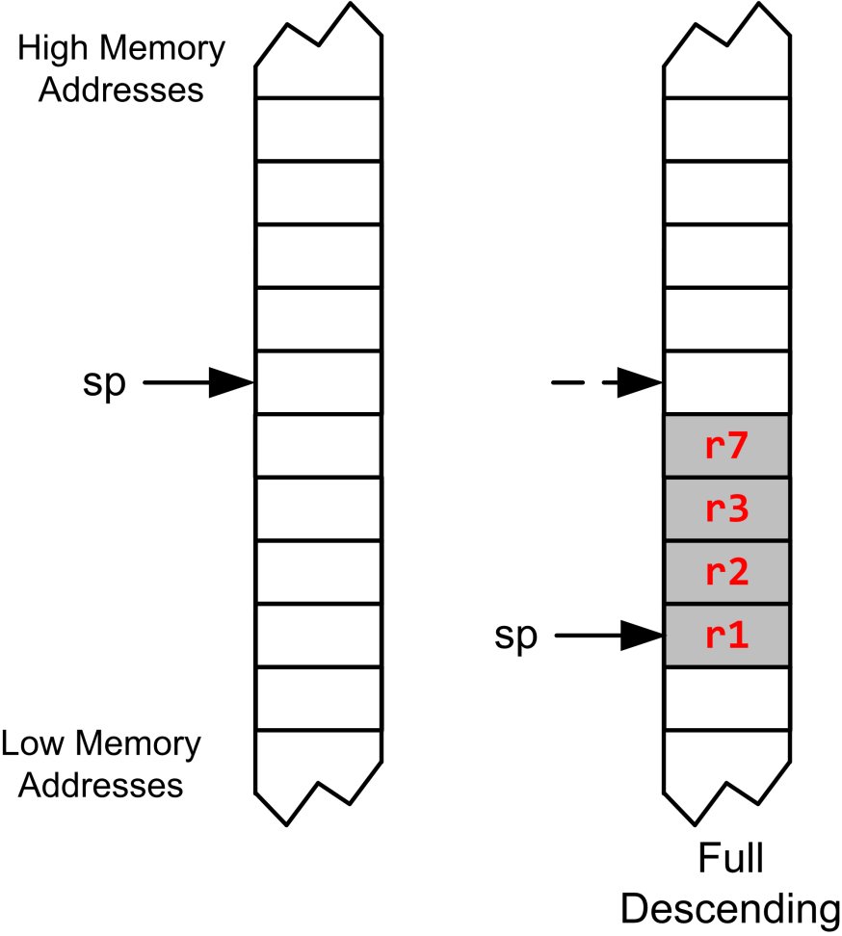
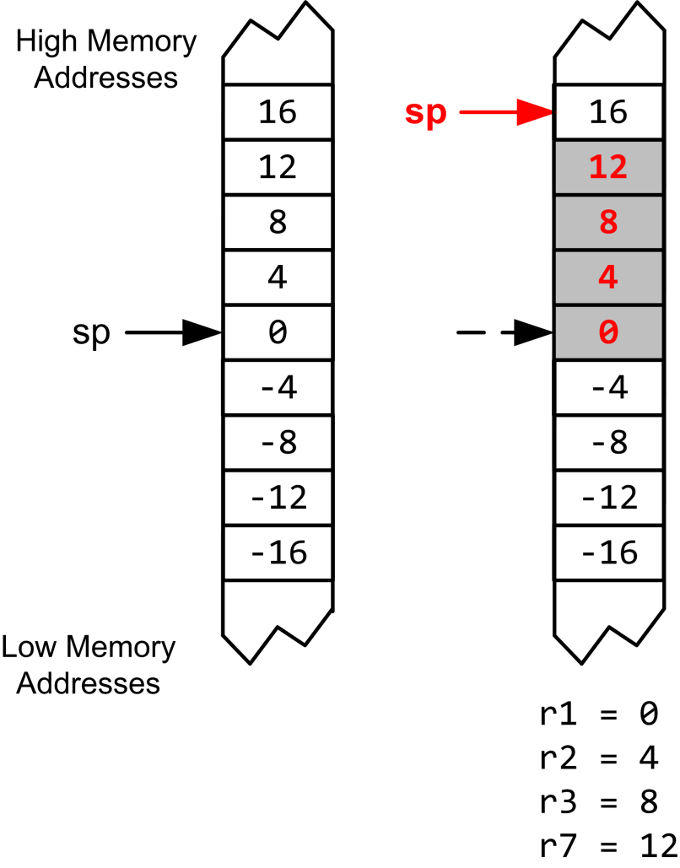
Full Descending Stack
PUSH {r1, r3, r2, r7}
POP {r3, r1, r7, r2}

Slide 8
Stack
PUSH {r3, r1, r7, r2}
POP {r3, r1, r7, r2}

Slide 9
Stack
PUSH {r1, r2, r3, r7}
POP {r3, r1, r7, r2}

Slide 10
Recursive Procedure Example
C code:
int fact (int n)
{
if (n <
1)
return 1;
else return n * fact(n - 1);
}

Slide 11
Recursive Functions
push LR (& working registers) onto stack before nested call
pop LR (& working registers) off stack after nested return

Slide 12
Recursive Factorial in Assembly
.global main
main:
MOV r0, #0x03
BL factorial
B stop
factorial: PUSH {r4, lr}
MOV r4, r0
CMP r4, #0x01
BGE NZ
MOVS r0, #0x01
loop: POP {r4, pc}
NZ: SUBS r0, r4, #1
BL factorial
MUL r0, r4, r0
B loop
stop:
MOV r7, #1
SWI 0
return 6
0x08000130
3 * factorial(2)
0x08000134
return 2
0x08000136
2 * factorial(1)
0x08000138
0x0800013A
1
0x0800013C
0x0800013E
0x08000140
0x08000142
0x08000144
0x08000148
0x0800014C

Slide 13
Recursive Factorial in Assembly
Data
Address
.global __main
__main
MOV r0, #0x03
BL factorial
B stop
factorial PUSH {r4, lr}
MOV r4, r0
CMP r4, #0x01
BNE NZ
MOVS r0, #0x01
loop POP {r4, pc}
NZ SUBS r0, r4, #1
BL factorial
MUL r0, r4, r0
B loop
stop:
MOV r7, #1
SWI 0
pc
0xFFFFFFFF
0x08000130
…
0xFFFFFFFF
lr
0x20000600
sp
0x12345678
0x20000600
0x200005FC
…
0x200005F8
0x08000130
0x200005F4
0x08000134
0
r4
0x200005F0
…
0x200005EC
0x08000136
0x200005E8
0x08000138
3
r0
0x0800013A
0x200005E4
0x0800013C
0x200005E0
0x0800013E
0x08000140
0x200005DC
0x08000142
0x200005D8
0x08000144
0x08000148
0x200005D4
0x0800014C
…
0x00000000
Memory

Slide 14
Recursive Factorial in Assembly
Data
Address
.global __main
__main
MOV r0, #0x03
BL factorial
B stop
factorial: PUSH {r4, lr}
MOV r4, r0
CMP r4, #0x01
BGE NZ
MOVS r0, #0x01
loop POP {r4, pc}
NZ SUBS r0, r4, #1
BL factorial
MUL r0, r4, r0
B loop
stop:
MOV r7, #1
SWI 0
pc
0xFFFFFFFF
0x08000136
…
0x08000134
lr
0x20000600
sp
0x12345678
0x20000600
0x200005FC
…
0x200005F8
0x08000130
0x200005F4
0x08000134
0
r4
0x200005F0
0x08000136
…
0x200005EC
0x08000138
0x200005E8
0x0800013A
3
r0
0x200005E4
0x0800013C
0x0800013E
0x200005E0
0x08000140
0x200005DC
0x08000142
0x200005D8
0x08000144
0x200005D4
0x08000148
0x0800014C
…
0x00000000
Memory

Slide 15
Recursive Factorial in Assembly
Data
Address
.global __main
__main
MOV r0, #0x03
BL factorial
B stop
factorial PUSH {r4, lr}
MOV r4, r0
CMP r4, #0x01
BGE NZ
MOVS r0, #0x01
loop POP {r4, pc}
NZ SUBS r0, r4, #1
BL factorial
MUL r0, r4, r0
B loop
stop:
MOV r7, #1
SWI 0
pc
0xFFFFFFFF
0x08000138
…
0x08000134
lr
0x200005F8
sp
0x12345678
0x20000600
0x08000134
0x200005FC
…
0x08000130
0
0x200005F8
0x08000134
0x200005F4
0
r4
0x200005F0
…
0x200005EC
0x08000136
0x200005E8
0x08000138
3
r0
0x0800013A
0x200005E4
0x0800013C
0x200005E0
0x0800013E
Order in which registers are specified is not important: the lowest register is always stored at the lowest address
0x08000140
0x200005DC
0x08000142
0x200005D8
0x08000144
0x08000148
0x200005D4
0x0800014C
…
0x00000000
Memory

Slide 16
Recursive Factorial in Assembly
Data
Address
.global __main
__main
MOV r0, #0x03
BL factorial
B stop
factorial PUSH {r4, lr}
MOV r4, r0
CMP r4, #0x01
BGE NZ
MOVS r0, #0x01
loop POP {r4, pc}
NZ SUBS r0, r4, #1
BL factorial
MUL r0, r4, r0
B loop
stop:
MOV r7, #1
SWI 0
pc
0xFFFFFFFF
0x0800013A
…
0x08000134
lr
0x200005F8
sp
0x12345678
0x20000600
0x08000134
0x200005FC
…
0x08000130
0
0x200005F8
0x08000134
0x200005F4
3
r4
0x200005F0
…
0x200005EC
0x08000136
0x200005E8
0x08000138
3
r0
0x0800013A
0x200005E4
0x0800013C
0x200005E0
0x0800013E
0x08000140
0x200005DC
0x08000142
0x200005D8
0x08000144
0x08000148
0x200005D4
0x0800014C
…
0x00000000
Memory

Slide 17
Recursive Factorial in Assembly
Data
Address
.global __main
__main:
MOV r0, #0x04
BL factorial
B stop
factorial: PUSH {r4, lr}
MOV r4, r0
CMP r4, #0x01
BGE NZ
MOVS r0, #0x01
loop: POP {r4, pc}
NZ: SUBS r0, r4, #1
BL factorial
MUL r0, r4, r0
B loop
stop:
MOV r7, #1
SWI 0
pc
0xFFFFFFFF
0x08000144
…
0x08000134
lr
0x08000130
0x200005F8
sp
0x12345678
0x20000600
0x08000134
0x08000134
0x200005FC
…
0
0x200005F8
0x200005F4
3
r4
0x200005F0
0x08000136
…
0x200005EC
0x08000138
0x200005E8
0x0800013A
2
r0
0x0800013C
0x200005E4
0x0800013E
0x200005E0
0x08000140
0x08000142
0x200005DC
0x08000144
0x200005D8
0x08000148
0x0800014C
0x200005D4
…
0x00000000
Memory

Slide 18
Recursive Factorial in Assembly
Data
Address
.global __main
__main
MOV r0, #0x03
BL factorial
B stop
factorial
PUSH {r4, lr}
MOV r4, r0
CMP r4, #0x01
BNE NZ
MOVS r0, #0x01
loop POP {r4, pc}
NZ SUBS r0, r4, #1
BL factorial
MUL r0, r4, r0
B loop
stop:
MOV r7, #1
SWI 0
pc
0xFFFFFFFF
0x08000136
…
0x08000148
lr
0x200005F8
sp
0x12345678
0x20000600
0x08000134
0x200005FC
…
0x08000130
0
0x200005F8
0x08000134
0x200005F4
3
r4
0x200005F0
…
0x200005EC
0x08000136
0x200005E8
0x08000138
2
r0
0x0800013A
0x200005E4
0x0800013C
0x200005E0
0x0800013E
0x08000140
0x200005DC
0x08000142
0x200005D8
0x08000144
0x08000148
0x200005D4
0x0800014C
…
0x00000000
Memory

Slide 19
Recursive Factorial in Assembly
Data
Address
.global __main
__main
MOV r0, #0x03
BL factorial
B stop
factorial
PUSH {r4, lr}
MOV r4, r0
CMP r4, #0x01
BNE NZ
MOVS r0, #0x01
loop POP {r4, pc}
NZ SUBS r0, r4, #1
BL factorial
MUL r0, r4, r0
B loop
stop:
MOV r7, #1
SWI 0
pc
0xFFFFFFFF
0x08000138
…
0x08000148
lr
0x200005F0
sp
0x12345678
0x20000600
0x08000134
0x200005FC
…
0x08000130
0
0x200005F8
0x08000134
0x08000148
0x200005F4
3
r4
3
0x200005F0
…
0x200005EC
0x08000136
0x200005E8
0x08000138
2
r0
0x0800013A
0x200005E4
0x0800013C
0x200005E0
0x0800013E
0x08000140
0x200005DC
0x08000142
0x200005D8
0x08000144
0x08000148
0x200005D4
0x0800014C
…
0x00000000
Memory

Slide 20
Recursive Factorial in Assembly
Data
Address
.global __main
__main
MOV r0, #0x03
BL factorial
B stop
factorial
PUSH {r4, lr}
MOV r4, r0
CMP r4, #0x01
BNE NZ
MOVS r0, #0x01
loop POP {r4, pc}
NZ SUBS r0, r4, #1
BL factorial
MUL r0, r4, r0
B loop
stop:
MOV r7, #1
SWI 0
pc
0xFFFFFFFF
0x0800013A
…
0x08000148
lr
0x200005F0
sp
0x12345678
0x20000600
0x08000134
0x200005FC
…
0x08000130
0
0x200005F8
0x08000134
0x08000148
0x200005F4
2
r4
3
0x200005F0
…
0x200005EC
0x08000136
0x200005E8
0x08000138
2
r0
0x0800013A
0x200005E4
0x0800013C
0x200005E0
0x0800013E
0x08000140
0x200005DC
0x08000142
0x200005D8
0x08000144
0x08000148
0x200005D4
0x0800014C
…
0x00000000
Memory

Slide 21
Recursive Factorial in Assembly
Data
Address
.global __main
__main
MOV r0, #0x03
BL factorial
B stop
factorial
PUSH {r4, lr}
MOV r4, r0
CMP r4, #0x01
BGE NZ
MOVS r0, #0x01
loop POP {r4, pc}
NZ SUBS r0, r4, #1
BL factorial
MUL r0, r4, r0
B loop
stop:
MOV r7, #1
SWI 0
pc
0xFFFFFFFF
0x08000144
…
0x08000148
lr
0x200005F0
sp
0x12345678
0x20000600
0x08000134
0x200005FC
…
0x08000130
0
0x200005F8
0x08000134
0x08000148
0x200005F4
2
r4
3
0x200005F0
…
0x200005EC
0x08000136
0x200005E8
0x08000138
1
r0
0x0800013A
0x200005E4
0x0800013C
0x200005E0
0x0800013E
0x08000140
0x200005DC
0x08000142
0x200005D8
0x08000144
0x08000148
0x200005D4
0x0800014C
…
0x00000000
Memory

Slide 22
Recursive Factorial in Assembly
Data
Address
.global __main
__main
MOV r0, #0x03
BL factorial
B stop
factorial
PUSH {r4, lr}
MOV r4, r0
CMP r4, #0x01
BNE NZ
MOVS r0, #0x01
loop POP {r4, pc}
NZ SUBS r0, r4, #1
BL factorial
MUL r0, r4, r0
B loop
stop:
MOV r7, #1
SWI 0
pc
0xFFFFFFFF
0x08000136
…
0x08000148
lr
0x200005F0
sp
0x12345678
0x20000600
0x08000134
0x200005FC
…
0x08000130
0
0x200005F8
0x08000134
0x08000148
0x200005F4
2
r4
3
0x200005F0
…
0x200005EC
0x08000136
0x200005E8
0x08000138
1
r0
0x0800013A
0x200005E4
0x0800013C
0x200005E0
0x0800013E
0x08000140
0x200005DC
0x08000142
0x200005D8
0x08000144
0x08000148
0x200005D4
0x0800014C
…
0x00000000
Memory

Slide 23
Recursive Factorial in Assembly
Data
Address
.global __main
__main
MOV r0, #0x03
BL factorial
B stop
factorial
PUSH {r4, lr}
MOV r4, r0
CMP r4, #0x01
BNE NZ
MOVS r0, #0x01
loop POP {r4, pc}
NZ SUBS r0, r4, #1
BL factorial
MUL r0, r4, r0
B loop
stop:
MOV r7, #1
SWI 0
pc
0xFFFFFFFF
0x08000138
…
0x08000148
lr
0x200005E8
sp
0x12345678
0x20000600
0x08000134
0x200005FC
…
0x08000130
0
0x200005F8
0x08000134
0x08000148
0x200005F4
2
r4
3
0x200005F0
…
0x08000148
0x200005EC
0x08000136
2
0x200005E8
0x08000138
1
r0
0x0800013A
0x200005E4
0x0800013C
0x200005E0
0x0800013E
0x08000140
0x200005DC
0x08000142
0x200005D8
0x08000144
0x08000148
0x200005D4
0x0800014C
…
0x00000000
Memory

Slide 24
Recursive Factorial in Assembly
Data
Address
.global __main
__main
MOV r0, #0x03
BL factorial
B stop
factorial
PUSH {r4, lr}
MOV r4, r0
CMP r4, #0x01
BNE NZ
MOVS r0, #0x01
loop POP {r4, pc}
NZ SUBS r0, r4, #1
BL factorial
MUL r0, r4, r0
B loop
stop:
MOV r7, #1
SWI 0
pc
0xFFFFFFFF
0x0800013A
…
0x08000148
lr
0x200005E8
sp
0x12345678
0x20000600
0x08000134
0x200005FC
…
0x08000130
0
0x200005F8
0x08000134
0x08000148
0x200005F4
1
r4
3
0x200005F0
…
0x08000148
0x200005EC
0x08000136
2
0x200005E8
0x08000138
1
r0
0x0800013A
0x200005E4
0x0800013C
0x200005E0
0x0800013E
0x08000140
0x200005DC
0x08000142
0x200005D8
0x08000144
0x08000148
0x200005D4
0x0800014C
…
0x00000000
Memory

Slide 25
Recursive Factorial in Assembly
Data
Address
.global __main
__main
MOV r0, #0x03
BL factorial
B stop
factorial
PUSH {r4, lr}
MOV r4, r0
CMP r4, #0x01
BNE NZ
MOVS r0, #0x01
loop POP {r4, pc}
NZ SUBS r0, r4, #1
BL factorial
MUL r0, r4, r0
B loop
stop:
MOV r7, #1
SWI 0
pc
0xFFFFFFFF
0x0800013E
…
0x08000148
lr
0x200005E8
sp
0x12345678
0x20000600
0x08000134
0x200005FC
…
0x08000130
0
0x200005F8
0x08000134
0x08000148
0x200005F4
1
r4
3
0x200005F0
…
0x08000148
0x200005EC
0x08000136
2
0x200005E8
0x08000138
1
r0
0x0800013A
0x200005E4
0x0800013C
0x200005E0
0x0800013E
0x08000140
0x200005DC
0x08000142
0x200005D8
0x08000144
0x08000148
0x200005D4
0x0800014C
…
0x00000000
Memory

Slide 26
Recursive Factorial in Assembly
Data
Address
.global __main
__main
MOV r0, #0x03
BL factorial
B stop
factorial
PUSH {r4, lr}
MOV r4, r0
CMP r4, #0x01
BNE NZ
MOVS r0, #0x01
loop POP {r4, pc}
NZ SUBS r0, r4, #1
BL factorial
MUL r0, r4, r0
B loop
stop:
MOV r7, #1
SWI 0
pc
0xFFFFFFFF
0x08000140
…
0x08000148
lr
0x200005E8
sp
0x12345678
0x20000600
0x08000134
0x200005FC
…
0x08000130
0
0x200005F8
0x08000134
0x08000148
0x200005F4
1
r4
3
0x200005F0
…
0x08000148
0x200005EC
0x08000136
2
0x200005E8
0x08000138
1
r0
0x0800013A
0x200005E4
0x0800013C
0x200005E0
0x0800013E
0x08000140
0x200005DC
0x08000142
0x200005D8
0x08000144
0x08000148
0x200005D4
0x0800014C
…
0x00000000
Memory

Slide 27
Recursive Factorial in Assembly
Data
Address
.global __main
__main
MOV r0, #0x03
BL factorial
B stop
factorial
PUSH {r4, lr}
MOV r4, r0
CMP r4, #0x01
BNE NZ
MOVS r0, #0x01
loop POP {r4, pc}
NZ SUBS r0, r4, #1
BL factorial
MUL r0, r4, r0
B loop
stop:
MOV r7, #1
SWI 0
pc
0xFFFFFFFF
0x08000148
…
0x08000148
lr
0x200005F0
sp
0x12345678
0x20000600
0x08000134
0x200005FC
…
0x08000130
0
0x200005F8
0x08000134
0x08000148
0x200005F4
2
r4
3
0x200005F0
…
0x200005EC
0x08000136
0x200005E8
0x08000138
1
r0
0x0800013A
0x200005E4
0x0800013C
0x200005E0
0x0800013E
0x08000140
0x200005DC
0x08000142
0x200005D8
0x08000144
0x08000148
0x200005D4
0x0800014C
…
0x00000000
Memory

Slide 28
Recursive Factorial in Assembly
Data
Address
.global __main
__main
MOV r0, #0x03
BL factorial
B stop
factorial
PUSH {r4, lr}
MOV r4, r0
CMP r4, #0x01
BNE NZ
MOVS r0, #0x01
loop POP {r4, pc}
NZ SUBS r0, r4, #1
BL factorial
MUL r0, r4, r0
B loop
stop:
MOV r7, #1
SWI 0
0x0800014C
pc
0xFFFFFFFF
…
0x08000148
lr
0x200005F0
sp
0x12345678
0x20000600
0x08000134
0x200005FC
…
0x08000130
0
0x200005F8
0x08000134
0x08000148
0x200005F4
2
r4
3
0x200005F0
…
0x200005EC
0x08000136
0x200005E8
0x08000138
2
r0
0x0800013A
0x200005E4
0x0800013C
0x200005E0
0x0800013E
0x08000140
0x200005DC
0x08000142
0x200005D8
0x08000144
0x08000148
0x200005D4
0x0800014C
…
0x00000000
Memory

Slide 29
Recursive Factorial in Assembly
Data
Address
.global __main
__main
MOV r0, #0x03
BL factorial
stop B stop
factorial
PUSH {r4, lr}
MOV r4, r0
CMP r4, #0x01
BNE NZ
MOVS r0, #0x01
loop POP {r4, pc}
NZ SUBS r0, r4, #1
BL factorial
MUL r0, r4, r0
B loop
stop:
MOV r7, #1
SWI 0
pc
0xFFFFFFFF
0x08000140
…
0x08000148
lr
0x200005F0
sp
0x12345678
0x20000600
0x08000134
0x200005FC
…
0x08000130
0
0x200005F8
0x08000134
0x08000148
0x200005F4
2
r4
3
0x200005F0
…
0x200005EC
0x08000136
0x200005E8
0x08000138
2
r0
0x0800013A
0x200005E4
0x0800013C
0x200005E0
0x0800013E
0x08000140
0x200005DC
0x08000142
Order in which registers are specified is not important.
0x200005D8
0x08000144
0x08000148
0x200005D4
0x0800014C
…
0x00000000
Memory

Slide 30
Recursive Factorial in Assembly
Data
Address
.global __main
__main
MOV r0, #0x03
BL factorial
stop B stop
factorial
PUSH {r4, lr}
MOV r4, r0
CMP r4, #0x01
BNE NZ
MOVS r0, #0x01
loop POP {r4, pc}
NZ SUBS r0, r4, #1
BL factorial
MUL r0, r4, r0
B loop
stop:
MOV r7, #1
SWI 0
pc
0xFFFFFFFF
0x08000148
…
0x08000148
lr
0x200005F8
sp
0x12345678
0x20000600
0x08000134
0x200005FC
…
0x08000130
0
0x200005F8
0x08000134
0x200005F4
3
r4
0x200005F0
…
0x200005EC
0x08000136
0x200005E8
0x08000138
2
r0
0x0800013A
0x200005E4
0x0800013C
0x200005E0
0x0800013E
0x08000140
0x200005DC
0x08000142
0x200005D8
0x08000144
0x08000148
0x200005D4
0x0800014C
…
0x00000000
Memory

Slide 31
Recursive Factorial in Assembly
Data
Address
.global __main
__main
MOV r0, #0x03
BL factorial
stop B stop
factorial
PUSH {r4, lr}
MOV r4, r0
CMP r4, #0x01
BNE NZ
MOVS r0, #0x01
loop POP {r4, pc}
NZ SUBS r0, r4, #1
BL factorial
MUL r0, r4, r0
B loop
stop:
MOV r7, #1
SWI 0
pc
0xFFFFFFFF
0x0800014C
…
0x08000148
lr
0x200005F8
sp
0x12345678
0x20000600
0x08000134
0x200005FC
…
0x08000130
0
0x200005F8
0x08000134
0x200005F4
3
r4
0x200005F0
…
0x200005EC
0x08000136
0x200005E8
0x08000138
6
r0
0x0800013A
0x200005E4
0x0800013C
0x200005E0
0x0800013E
0x08000140
0x200005DC
0x08000142
0x200005D8
0x08000144
0x08000148
0x200005D4
0x0800014C
…
0x00000000
Memory

Slide 32
Recursive Factorial in Assembly
Data
Address
.global __main
__main
MOV r0, #0x03
BL factorial
stop B stop
factorial
PUSH {r4, lr}
MOV r4, r0
CMP r4, #0x01
BNE NZ
MOVS r0, #0x01
loop POP {r4, pc}
NZ SUBS r0, r4, #1
BL factorial
MUL r0, r4, r0
B loop
stop:
MOV r7, #1
SWI 0
pc
0xFFFFFFFF
0x08000140
…
0x08000148
lr
0x200005F8
sp
0x12345678
0x20000600
0x08000134
0x200005FC
…
0x08000130
0
0x200005F8
0x08000134
0x200005F4
3
r4
0x200005F0
…
0x200005EC
0x08000136
0x200005E8
0x08000138
6
r0
0x0800013A
0x200005E4
0x0800013C
0x200005E0
0x0800013E
0x08000140
0x200005DC
0x08000142
0x200005D8
0x08000144
0x08000148
0x200005D4
0x0800014C
…
0x00000000
Memory

Slide 33
Recursive Factorial in Assembly
.global __main
__main
MOV r0, #0x03
BL factorial
B stop
factorial
PUSH {r4, lr}
MOV r4, r0
CMP r4, #0x01
BNE NZ
MOVS r0, #0x01
loop POP {r4, pc}
NZ SUBS r0, r4, #1
BL factorial
MUL r0, r4, r0
B loop
stop:
MOV r7, #1
SWI 0
Data
Address
0x08000134
pc
0xFFFFFFFF
…
0x08000148
lr
0x20000600
sp
0x12345678
0x20000600
0x200005FC
…
0x08000130
0x200005F8
0x08000134
0x200005F4
0
r4
0x200005F0
…
0x200005EC
0x08000136
0x200005E8
0x08000138
6
r0
0x0800013A
0x200005E4
0x0800013C
0x200005E0
0x0800013E
0x08000140
0x200005DC
0x08000142
0x200005D8
0x08000144
0x08000148
0x200005D4
0x0800014C
…
0x00000000
Memory

Slide 34
Recursive Factorial in Assembly
Data
Address
.global __main
__main
MOV r0, #0x03
BL factorial
B stop
factorial
PUSH {r4, lr}
MOV r4, r0
CMP r4, #0x01
BNE NZ
MOVS r0, #0x01
loop POP {r4, pc}
NZ SUBS r0, r4, #1
BL factorial
MUL r0, r4, r0
B loop
stop: MOV r7, #1
SWI 0
pc
0xFFFFFFFF
0x0800014E
…
0x08000148
lr
0x20000600
sp
0x12345678
0x20000600
0x200005FC
…
0x08000130
0x200005F8
0x08000134
0x200005F4
0
r4
0x200005F0
0x08000136
…
0x200005EC
0x08000138
0x200005E8
0x0800013A
6
r0
0x0800013C
0x200005E4
0x0800013E
0x200005E0
0x08000140
0x08000142
0x200005DC
0x08000144
0x200005D8
0x08000148
0x0800014C
0x200005D4
0x0800014E
…
0x00000000
Memory

Slide 35
Conclusion
Instructions so far:
Previously:
ADD,SUB,MUL,MULA, [U|S]MULL, [U|S]MLAL, RSB
AND, ORR, EOR, BIC
MOV, MVN
LSL, LSR, ASR, ROR
CMP, B{EQ,NE,LT,LE,GT,GE}
LDR, STR, LDRB, STRB, LDRH, STRH
BL, BX
New:
PUSH, POP
Registers we know so far
All of them!
Addressing mode so far
Most of them!

